Slide 1
CTP-TCP - Joint Experiments Highlights
Comparison of the pedestal stability on AUG, JET, and TCV has shown consistent dependence of the density pedestal scale length on the separatrix density, that the pedestal width is wider than the EPED1 model assumption and that the pedestal width correlates with the divertor neutral pressure.
Detachment control schemes were implemented in AUG, JET, and TCV showing the impact of divertor closure on detachment and neutral pressure.
A common framework for thermal event detection was developed for WEST, W7-X and ITER with the development of a common machine learning framework for real-time thermal event detection at WEST and W7-X, real-time heat load estimation with Neural Networks and reflection modelling for metallic and non-metallic walls.
Experiments in DIII-D showed that Helium seeding and n=3 magnetic resonant perturbation fields reduce the L to H power threshold by 30% in hydrogen plasmas with an ITER similar shape.

Slide 2
CTP-TCP - Tokamak Highlights
The extension of the EAST steady-state Operational regime towards the China Fusion Engineering Test Reactor (CFETR) with relevant performance with enhanced capabilities was achieved with high density, dominant electron heating, zero torque small Edge Localised Modes (ELMs) with Improved confinement.
Development of the high performance long-pulse discharges in KSTAR included high performance with low q_{min} discharges with Ohmic or Electron Cyclotron pre-heating frontend, efficient central Electron Cyclotron on-axis Current Drive, good confinement (both thermal and beam) and no sign of performance degradation for long pulses of 9 s. The longest pulse length of 91.6 s in KSTAR was achieved with 90 s in H-mode.
Operation in the MAST Upgrade Tokamak with the Super X divertor has shown a 10 times reduction in the divertor peak heat flux and a 2 times reduction in the upstream density to detach outer divertors when compared with conventional divertors.

Slide 3
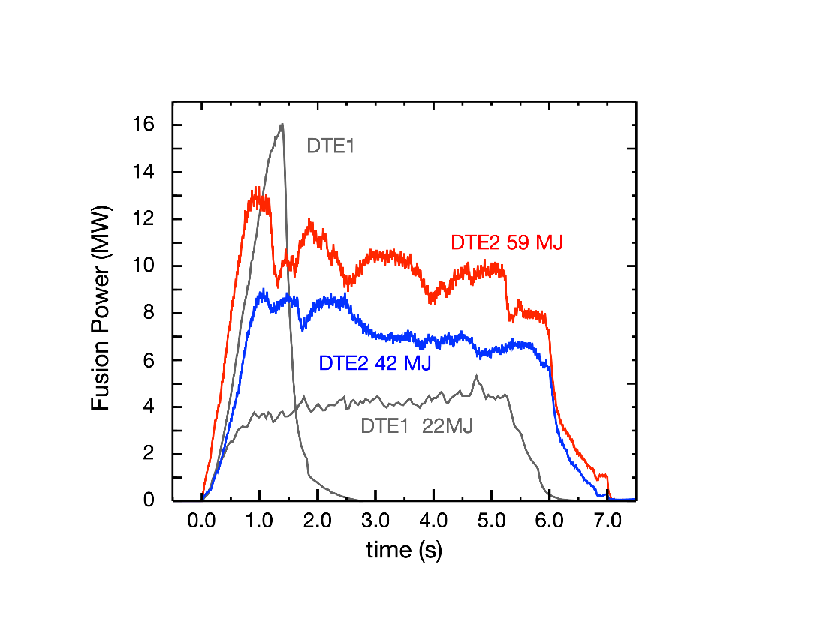
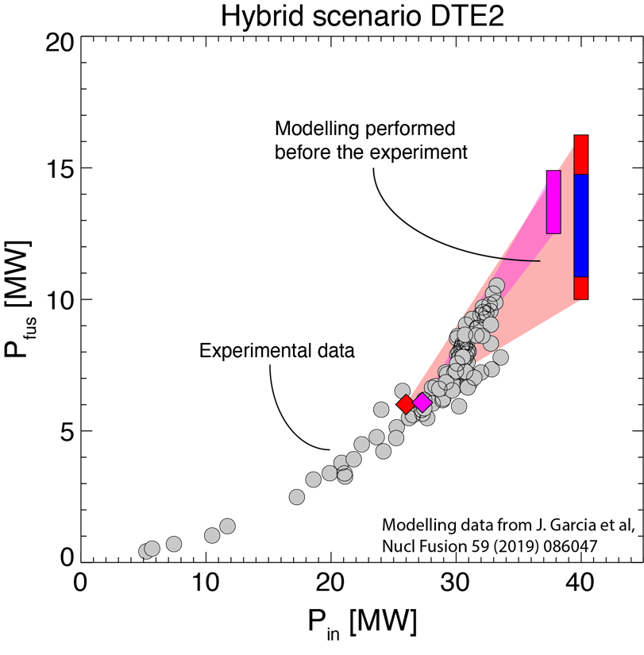
JET DTE2: Record fusion energy & unique physics results
Sustained high performance D-T plasmas compatible with ITER-like wall
Fusion power consistent with predictions made pre-DTE2
Selected highlights (analysis on-going):
P_{L-H} reduced compared to D plasmas
Improved energy confinement
Pedestal pressure depends on D-T mix
Small ELMs at low collisionality
Clear observations of α losses and of α-driven instabilities
ITER relevant D-T ICRF schemes: 3He minority heating & 3-ion D-⁹Be-T
Seeded plasmas with ITER relevant configuration
→ unique set of data for validation of models and codes, in support of future fusion devices

